Slide 1
You're a Human-Centered Designer! Trust me!
Sharing an essential government skill set for service success
2021 User Experience Summit
June 24, 2021

Slide 2
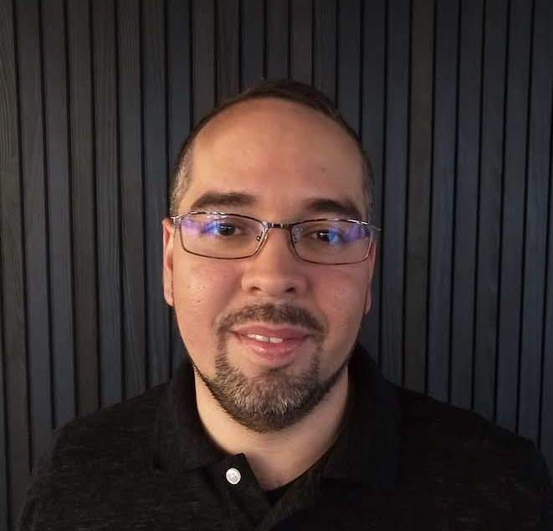


Hello from CMS!
Alberto Colón Viera
Nicole
Pham
Sarah
Tully
Engineer
Product Manager
Product Manager

Slide 3


We work within the Centers for Medicare & Medicaid Services (CMS), which is within the Department of Health & Human Services (DHHS)

Slide 4
A NON-EXHAUSTIVE LIST OF CMS SERVICES
MEDICARE
MEDICAID
A national health insurance program that primarily provides healthcare to Americans aged 65 and older, certain younger people with disabilities and people with ESRD.
A joint federal and state program that provides services to low income individuals, older adults, people with disabilities, children, and pregnant people.
CHIP
HEALTH INSURANCE MARKETPLACE
The Children’s Health Insurance Program provides federal matching funds to states to provide health coverage to children in families with incomes too high to qualify for Medicaid, but who can’t afford private coverage.
A service operated under provisions of the Affordable Care Act of 2010 that helps individuals, families, and small businesses shop for and enroll in private, commercial medical insurance.

Slide 5
SO YOU JUST VISITED YOUR DOCTOR...

Slide 6
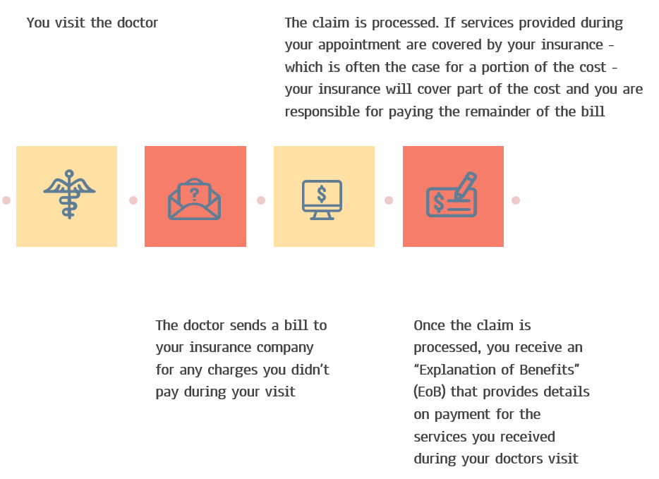
Medicare claims represent a history of services
Think about the last time you had a pap smear or a flu shot. Can you recall the specific date? Month? Year? I can’t!
That is just a small example of the critical health data that is present in your medical claims data. That is the meat of the data we are talking about when we talk about sending “claims” data outside of CMS.
Image description: A schematic workflow, from a doctor visit to a bill being generated to a claim being processed.

Slide 7
We build the data engine that powers Medicare Claims
Our vision (where we want to be)
Transform U.S. healthcare by enabling outcome-driven care and empowering decision-makers with the data they need.
Our mission (where we are today)
Build customer-focused, standards-based products that enable health data access to beneficiaries, providers, and industry partners for improving healthcare delivery and care coordination

Slide 8
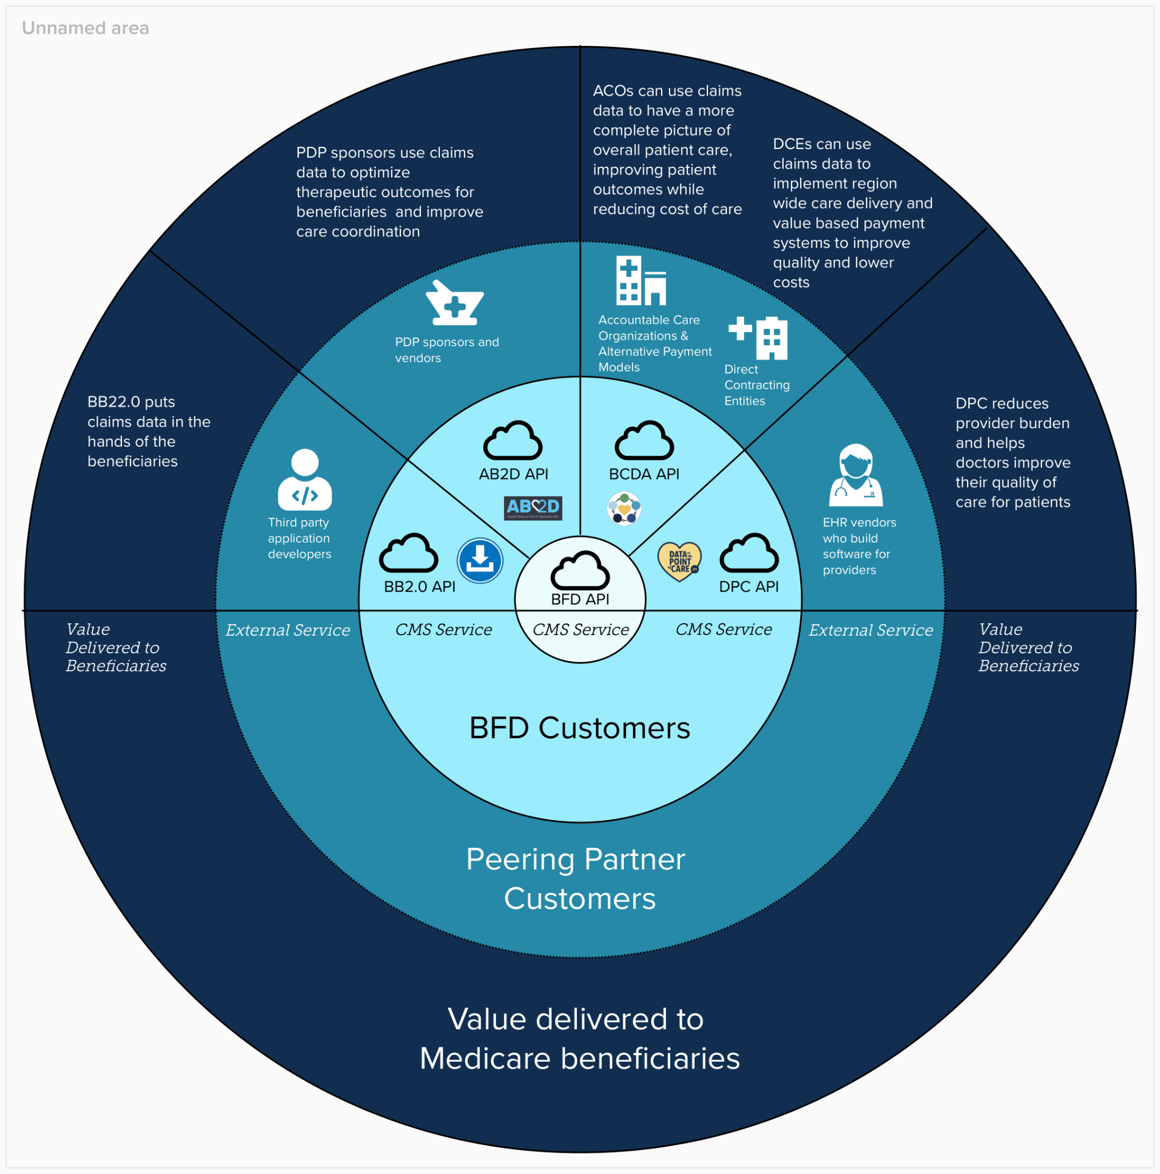
CMS Data and Analytics Strategy Group
This is a diagram of our services.

Slide 9
Our team is awesome but we don’t have the luxury of a federal HCD role
1
5
Product Managers
3
1
Security
Officer
Director
Engineers
4
6
60
Contracts
Delivery Teams
Contractors

Slide 10
Key values for how our team works
1
2
Empathy for users (and each other)
3
Design with users, not for them
Always be learning
Start with a mindset
Incorporate the mindset into designing and planning
Execute and iterate. It’s a continuous process!

Slide 11
Your values should influence everything you do
1
2
3
4
How you hire
Who you hire (Team composition)
How you plan, perform and measure the work
Who's your contracting partner

Slide 12
Human-Centered Design principles and methods help our team reach our goals

Slide 13
HCD concepts
Human-Centered Design is a methodology that puts the needs of people at the center of efforts to develop new and improved products, services and processes. It’s a set of tools and techniques that anyone can put in their toolbox.
What is HCD?
No one person has a monopoly on empathizing with your customer! An entire team can adopt a human-centered approach to product development: from ideation and problem definition to implementation and iteration.
Who owns HCD?
HCD is also a mentality: how can your team align its values and operations to be more human-centered?
How to do HCD?

Slide 14
Every service has the best intentions to meet the user, but here are the risks without HCD along the way
Risk of missing product usability and market fit
Use of services
Risk of lacking user enthusiasm and engagement
User satisfaction
Risk of wasting government resources and time
Government resources

Slide 15
Three phases of Human-Centered Design
1
2
3
Inspiration
Ideation
Implementation
Understand the challenge and get feedback from your users
Detangle what you’ve learned and identify themes
Prototype a solution and test with users
iteration

Slide 16
Human-Centered Design skills are a toolbox you add to with each new method you try

Slide 17

Do or Do not, there is no try - Yoda

Slide 18
Example HCD methods
Inspiration
Ideation
Implementation & Iteration
Define your ‘How Might We...’ statement
Stakeholder Mapping
User interviews
Detangle your feedback
Dot voting
Develop a prototype
Conduct usability testing

Slide 19
Inspiration Phase
Find your “How Might We” statement
Example Activity: find your “How Might We?”
Exercise Length: 10-30 minutes
When to utilize this method:
When you’re tempted to jump right into a solution
When you have a broad goal in mind and want to zero in on a bite-sized opportunity to tackle

Slide 20
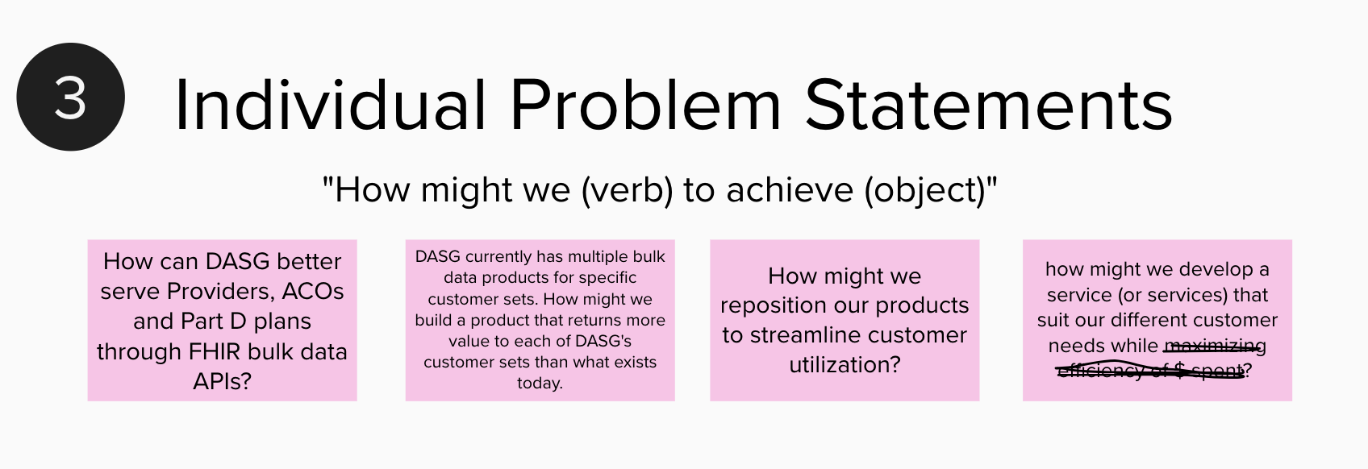
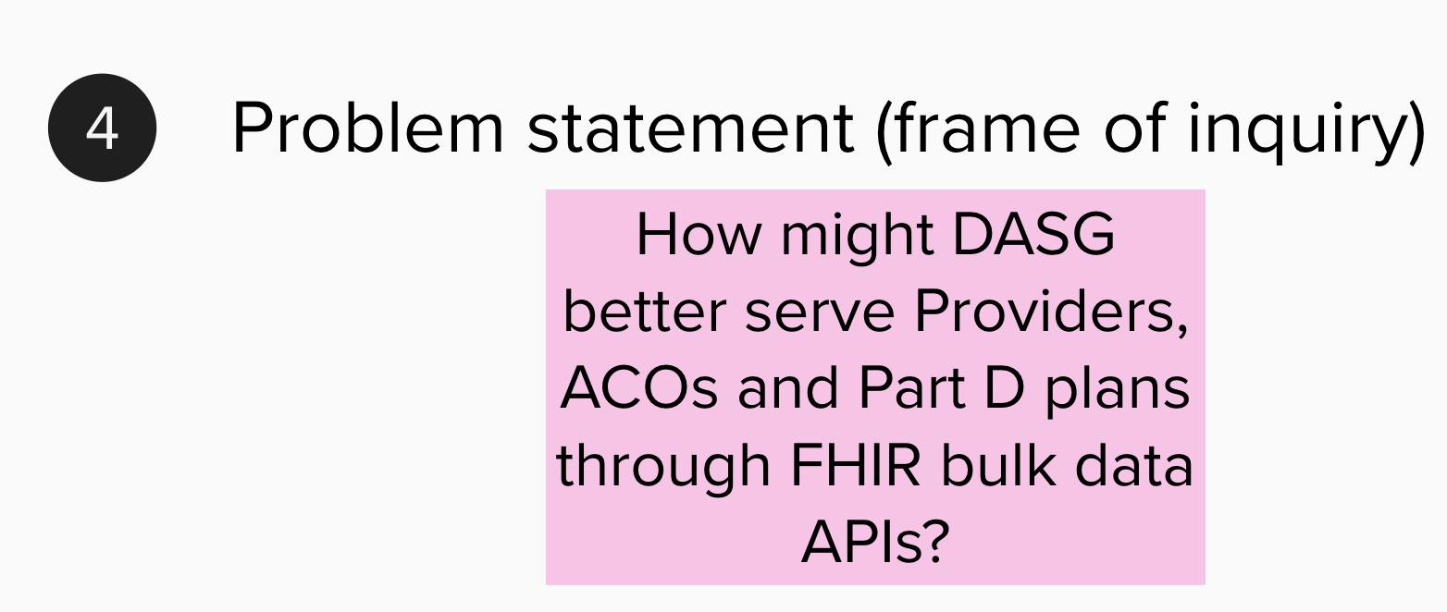
Example: Find your “How Might We” statement

Slide 21
Inspiration Phase
Stakeholder Mapping
Exercise Length: 30-60 minutes
When to utilize this method:
You have a particular problem or HMW statement you want to explore
You have a complex stakeholder and user landscape, and want to identify who to talk to from each
You’re need feedback from 3+ users

Slide 22
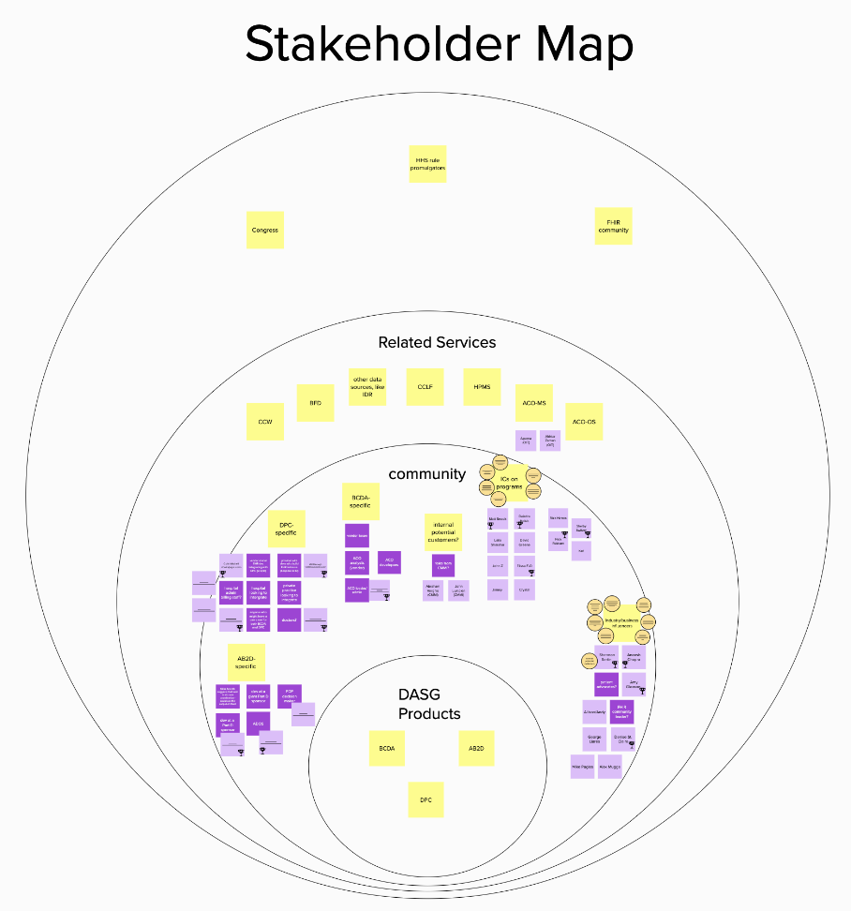
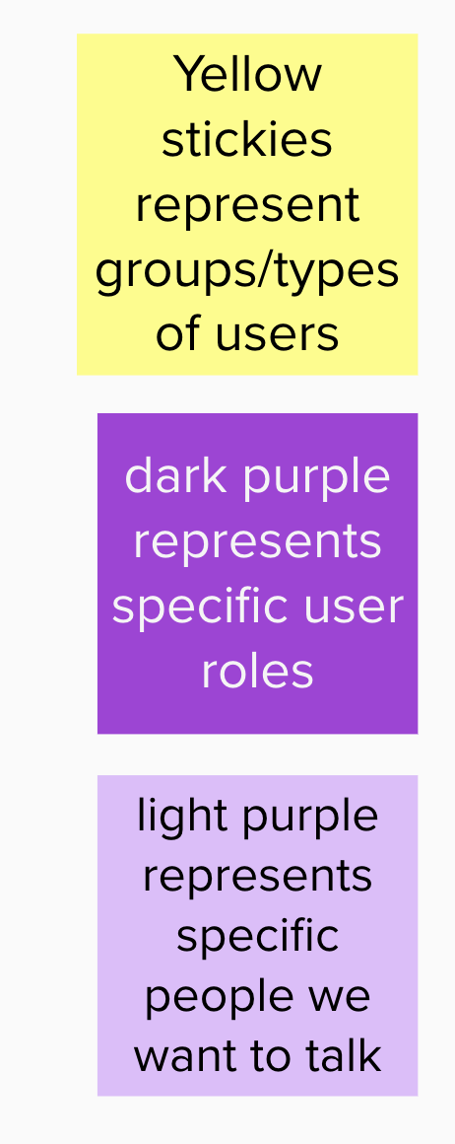
Inspiration Phase
Example: Stakeholder Mapping

Slide 23
Inspiration Phase
User Interview
Exercise Length: 30-60 minutes
Participants: facilitator & separate note taker (ideally observers as well)
When to utilize this method:
You’ve identified the problem you think you’re trying to solve (perhaps framed as a HMW opportunity) and what users you’d like to interview
You want feedback from your users to inform the solution you ultimately build

Slide 24

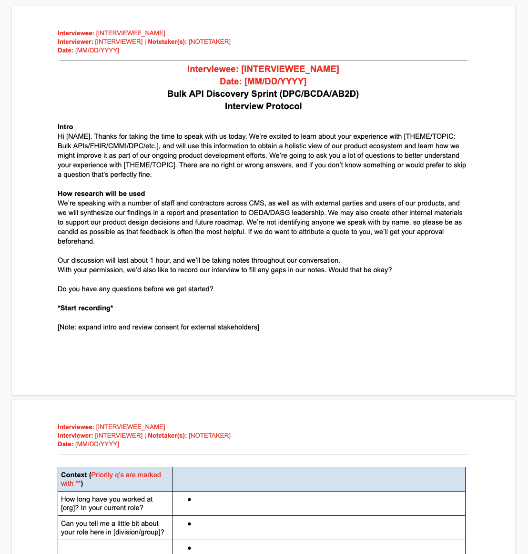
Inspiration Phase
Example: User Interview(s)

Slide 25
Ideation Phase
Detangle user feedback
Exercise Length: 1-3 hours
When to utilize this method:
You have conducted several user feedback sessions and have great notes or transcriptions from those sessions
You are seeking to identify themes and a potential path forward for a solution or prototype

Slide 26
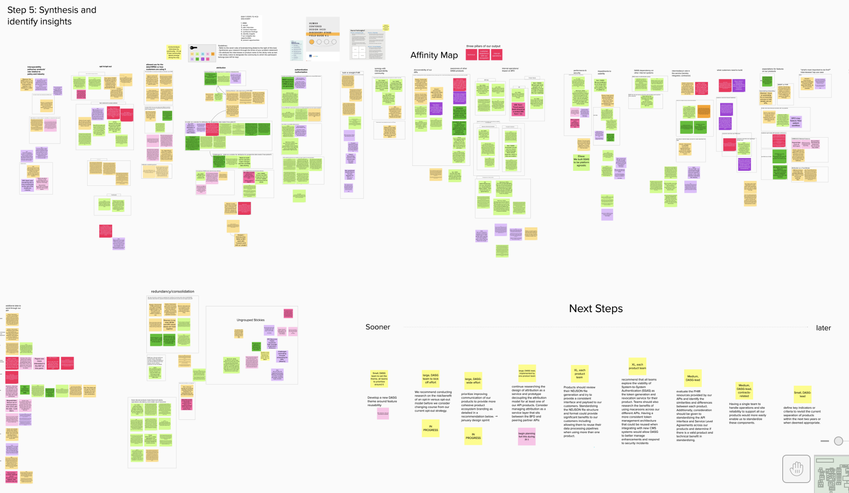
Ideation Phase
Example: Detangle user feedback

Slide 27
Implementation & Iteration Phase
Develop and usability test a prototype or presentation of findings
When to utilize this method:
The outcome you ultimately need to achieve is independently testable, such as a new web page, feature, or process
You’re looking to validate your design or findings before investing the time to develop a high fidelity solution

Slide 28
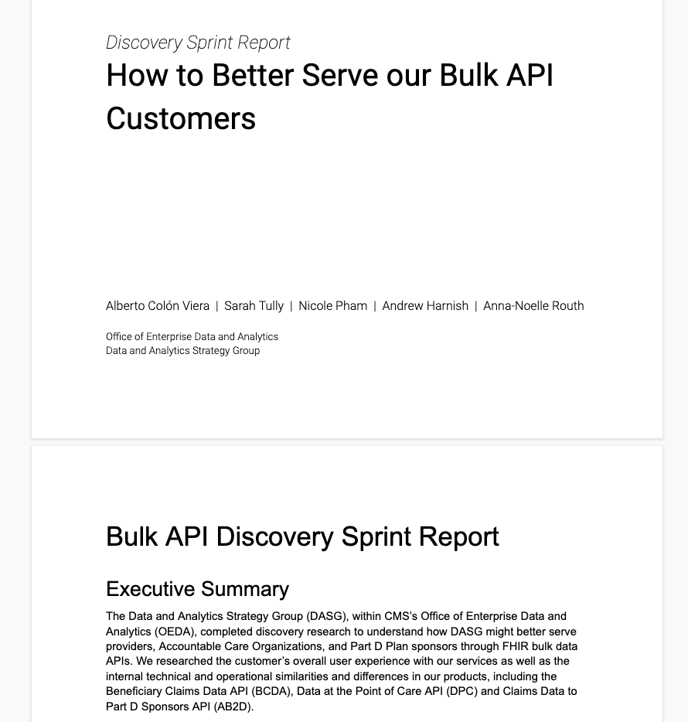
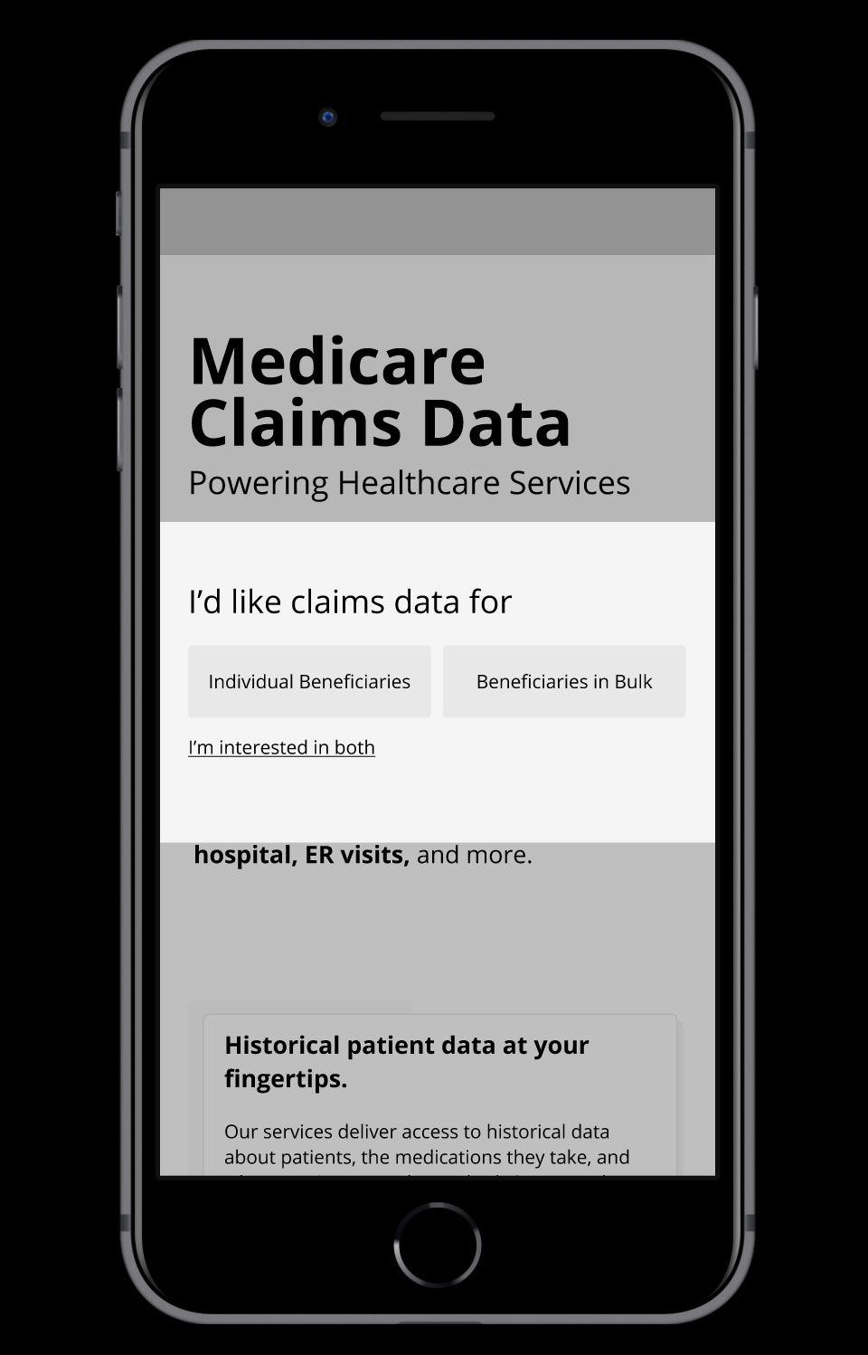
Implementation & Iteration Phase
Example: Develop and usability test a prototype or presentation of findings

Slide 29
DASG’s HCD process lifecyle in action
Discovery Sprint
iteration
Design Sprint
iteration

Slide 30
Now think of a time when you jumped “solution-first” into a project...
1
2
3
In the inspiration phase, what if you started with brainstorming “How Might We?” statements?
In the ideation phase, what if you spent an extra day to find themes in user feedback?
In the implementation phase, what if you released a smaller prototype first?

Slide 31
You might already be doing HCD!
Examples of activities you may be doing:
Facilitating requirements gathering or listening sessions
Project and sprint planning
User Acceptance Testing
Reframing the activities into HCD principles:
Build a greater understanding of your problem and the people it impacts
Creating testable solutions
Testing a design hypothesis

Slide 32
What is not HCD? And how to re-route?
Speaking for your users without speaking to your users
Doing HCD in a vacuum
Solely relying on design tools
Validate and test assumptions with users
It’s everyone’s job to develop the right solution to the right problem
Stick to the one or two tools that work best for your team

Slide 33
Build your toolbox (and help your peers build theirs, too)
1
2
3
4
Don’t be afraid to try out a new method. It’s better to spend more time understanding your problem than jump into developing a solution too quickly.
Build your HCD toolbox one method at a time.
Start with one!
Once you’re comfortable with one method, combine that tool with another, such as combining “HMW” statements with dot voting.
Teach your team to fish. Encourage others to facilitate sessions and practice ownership.

Slide 34
Human-Centered Design works best in tandem with other elements in a team’s toolbox:
Iterative Delivery
Service Design
Measuring Success
Using principles, tools, and governance for implementation
Researching, structuring, and planning your service
Measuring and understanding our own progression
Accessibility
Staffing
Technology
Helping people to use the services equitably
Ensuring the required roles, contractors, and training.
Ensuring the appropriate technology, tools, and securities.

Slide 35
Government can be more successful with HCD
1
2
3
HCD is not just for technology
HCD is never really over
It takes a village to raise a service
HCD can influence the intersection of policy and product services.
Both federal and contractor staff can own an HCD practice.
There’s always opportunity to improve the services for users.

Slide 36
Concluding thoughts
We’ve introduced our team, HCD concepts, and examples of methods. Becoming HCD designers hasn’t happened overnight; it has taken practice with a commitment to the aforementioned examples.
Next, it really comes down to what you and your team can do to embrace these values in the shared mindsets and actions.
What can you do tomorrow to embody Human-Centered Design in your work?

Slide 37
Thanks!
Do you have any questions?
Contact us at:
alberto.colonviera@cms.hhs.gov
sarah.tully@cms.hhs.gov
xuanphien.pham@cms.hhs.gov

Slide 38
Resources on Human-Centered Design
18F Methods
Design Kit methods
Design Kit resources
Gov.UK’s Service Manual
USDS Discovery Sprint Guide
GSA Discovery Stage Field Guide
"Good Services" website, book by Lou Downe
“A Civic Technologist’s Practice Guide” by Cyd Harrell

